Slide 1
Neurophysics 2015
Lecture I
(Learned) Goal Directed Behavior: Experiments and Theory w.r.t songbird vocal learning

Slide 2
Neurophysics course details
Room: HCI H 8.1 (Hoengg) or Y55G (Irchel)
Lectures: from 8:45 am onwards on Thursdays. A 15 min break after 45 mins.
Course schedule: will be emailed to you
Exam: Oral, 5 min presentation on topic of choice, followed by questions on any covered topic.
Homework assignments: 1 per week, submission one week later, by email (code and written).
Lecture slides: email (or website, if and when we have one….)
Teaching assistants:
Prof. Hahnloser’s group: Anja Zai and Arjun Bharadwaj.
Prof. Jean-Pascal Pfister’s group: Anna Kutschireiter

Slide 3
What are the theoretical and biological mechanisms that support learning of such behaviors?
What is goal directed behavior? And how can it be learned?
Why study bird song to understand learned behavior?

Slide 4
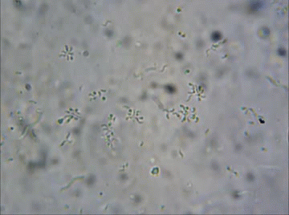
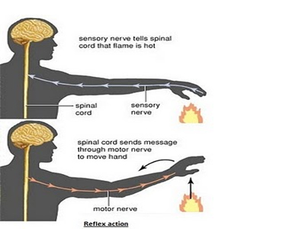
What is goal directed behavior?
Actions performed by agents in an environment to achieve a desired outcome (goal)
What kind of goals? Usually construed as a “reduction in error” or a “maximization of reward”
What is not goal directed behavior?
Hard to find an example!

Slide 5
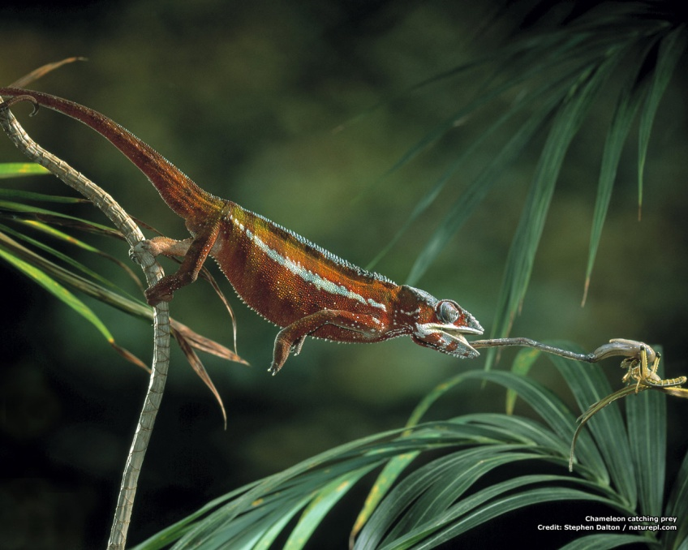
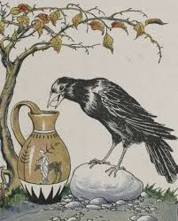
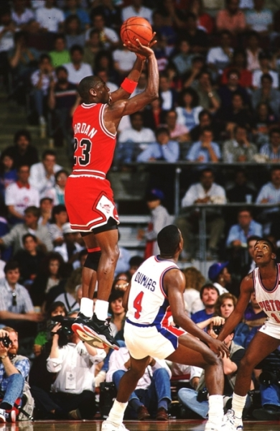
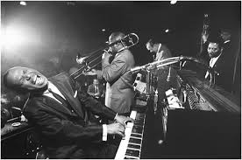

Slide 6
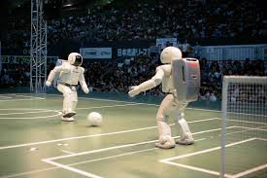
How to learn a difficult motor control problem?
Forward Models (predicting the outcomes of your actions)
Inverse Models (finding the actions that produced a desired outcome)
Reinforcement Learning (choosing the right action to maximize reward, when “error” is not available)

Slide 7
How does the brain solve (specific) motor control problems?

Slide 8
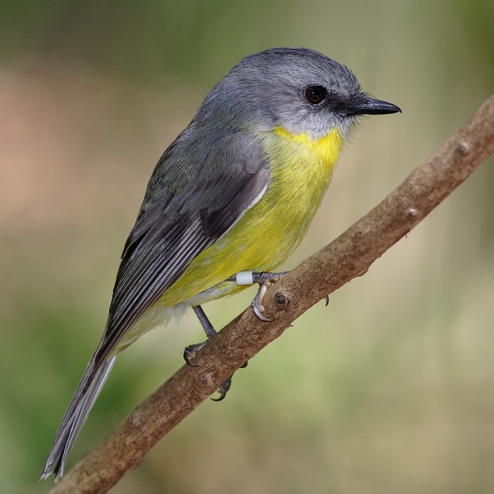
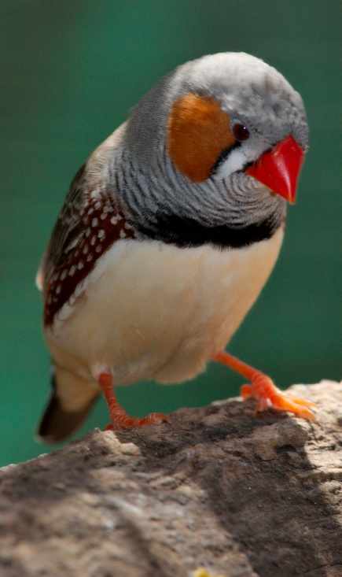
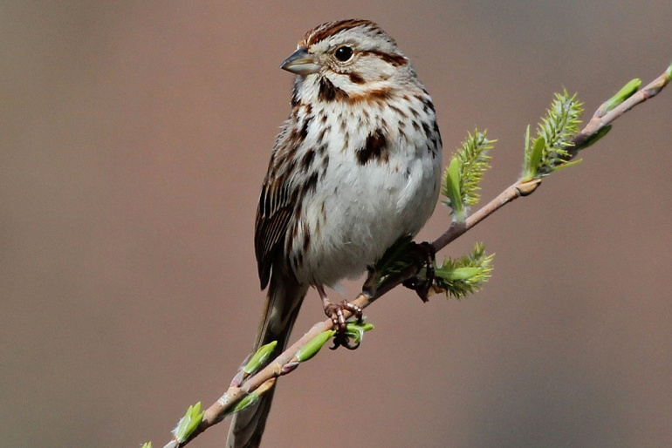
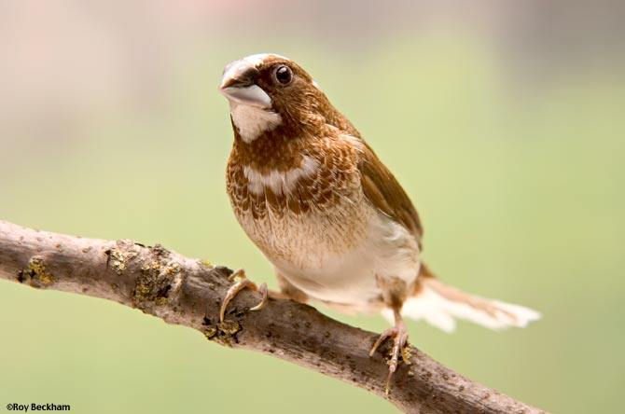
What is so special about songbirds?

Slide 9

Song sparrow

Slide 10
What can songbirds tell us about motor control?
Birdsong is a learned behavior just like human speech (Doupe & Kuhl 1999)
Similar developmental timeline
Similarities in speech related brain structures involved in processing
Learning how to sing requires:
An intact hearing apparatus (Konishi 1963) indicating a need for sensory feedback
A “tutor” an adult male bird (usually father) whose song is used as a model to be copied. This is the desired state of sensory feedback (Catchpole and Slater 1995).

Slide 11

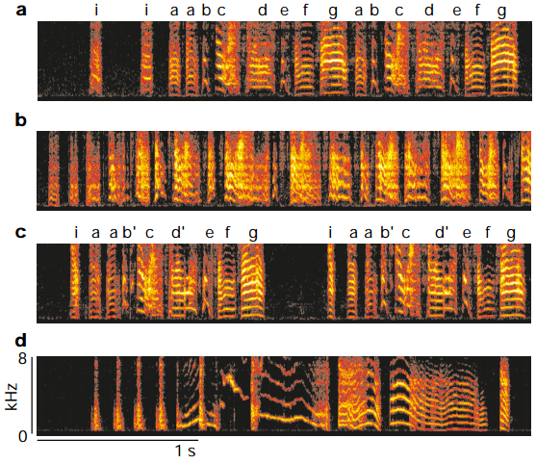
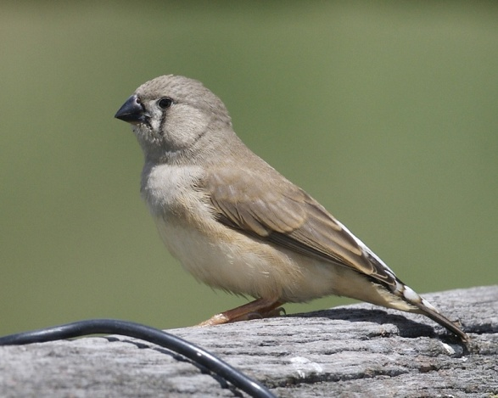
“Learning through practice: trial and error”
Isolate song

Slide 12
Which mechanisms aid learning?
1.Prediction error
2. Performance error
3. Reinforcement signals
4. Inverse Models

Slide 13
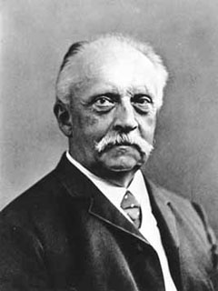
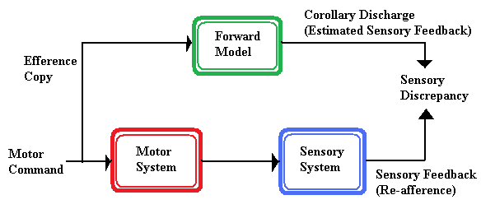
1. Prediction error
Main reason: Our brain doesn’t know what its muscles do from birth, therefore it must construct models of those muscles to approximate their effects.
Old idea: “Re-afference principle” Hermann Von Helmholtz (EYE BALL EXPERIMENT, tickling, Mormyrid electric fish etc.)
Compare a produced song (sensory space) y to a predicted sensation y~
Error = y - y~

Slide 14
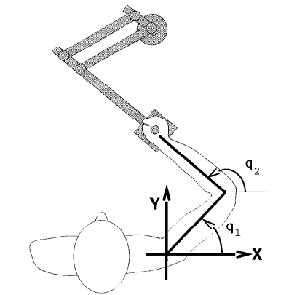
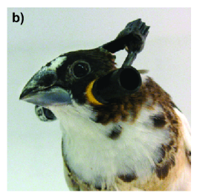
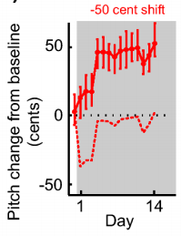
Motor adaptation experiments
Correcting biased pitch of song syllables
Sober and Brainard 2012
Correcting biased reach trajectories
Shadmehr and Mussa-Ivaldi 1994

Slide 15
Which mechanisms aid learning? 2. Performance error
Compare a produced song y to a desired song model y* (memory of tutor song)
Error = y* - y
u(t+1) = α*u(t) + gain*Error

Slide 16

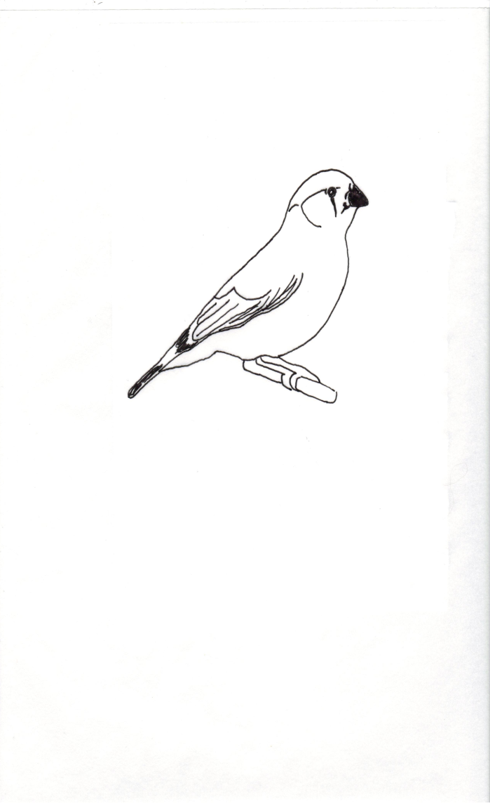
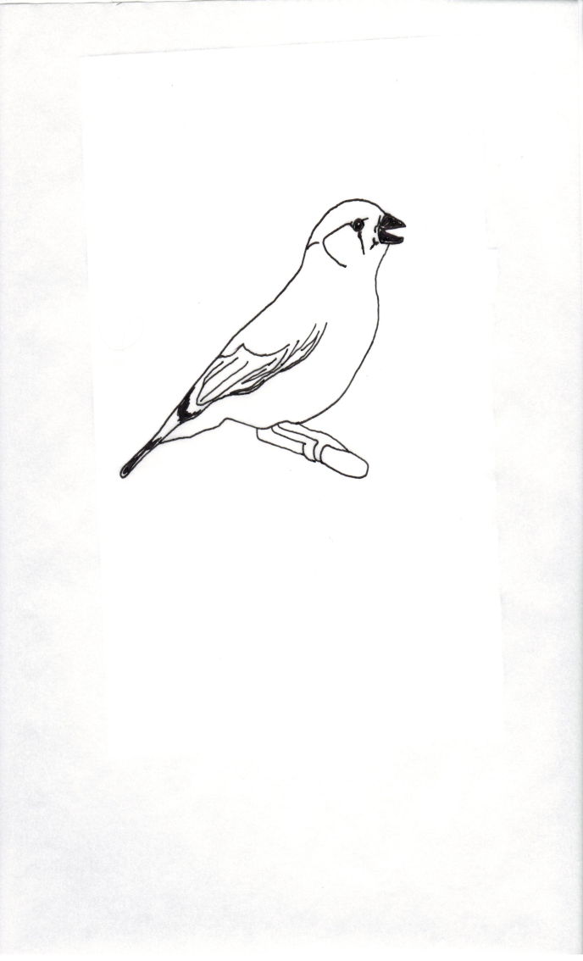
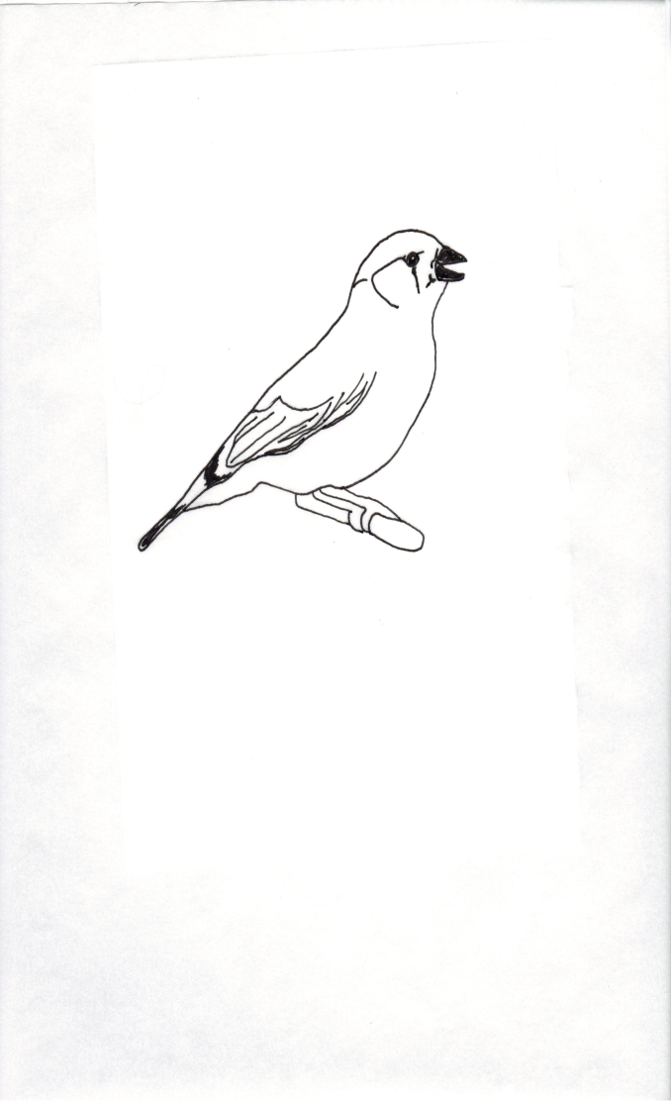
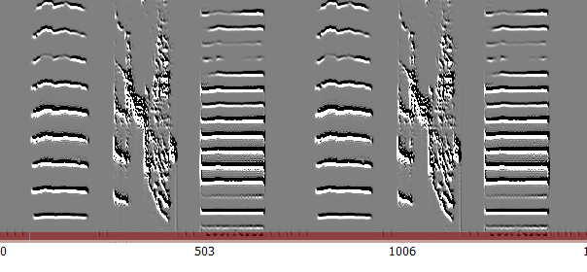
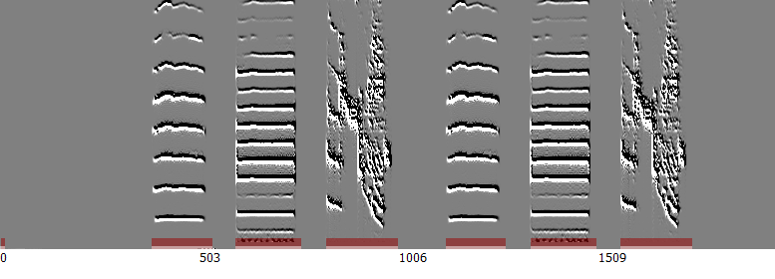
ABC
A’C’B
?
ABC
A’C’B
1310Hz
680Hz
780Hz
A’ C’ B A’ C’ B
1170Hz
A B C A B C
2kHz
100ms

Slide 17
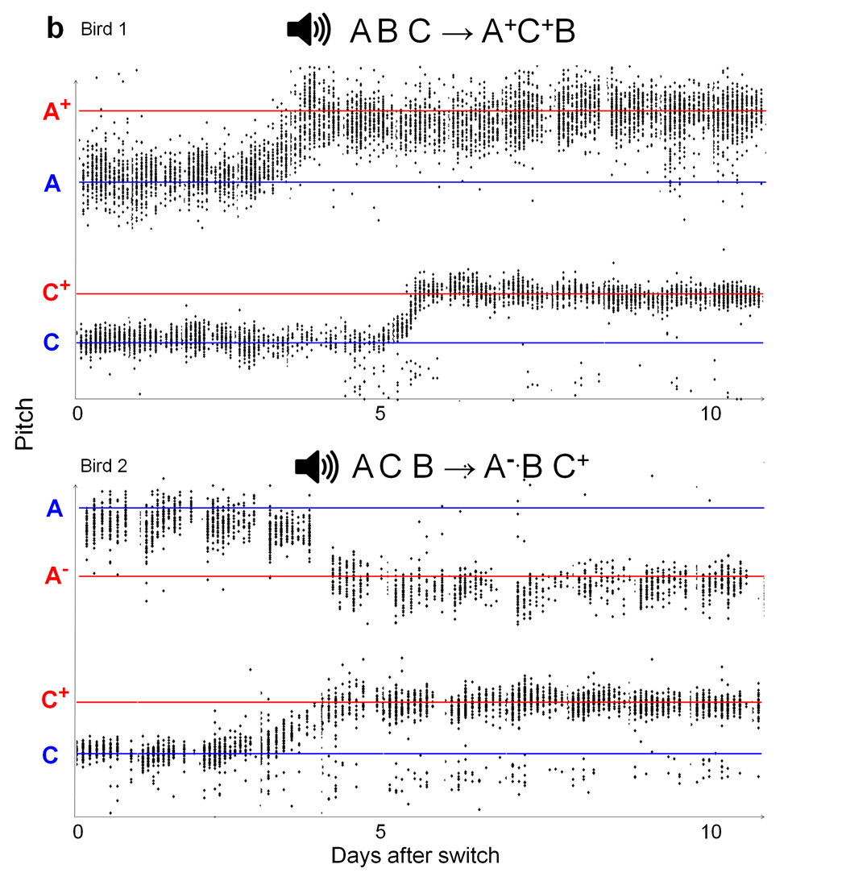

Slide 18
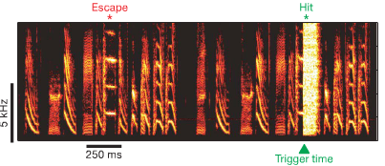
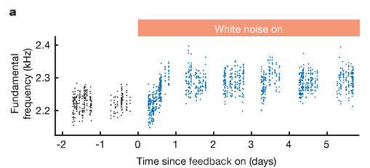
3. Reinforcement Learning
Explore the action space , find rewarding sensory states, and then be greedy!
START making actions u(t) that produce sensations y(t)
if sensation y → More Reward than usual , exploit the action!
if sensation y → Loss (less reward than usual) , explore again…
Tumer and Brainard 2007

Slide 19
4. Inverse Models
The aim is to choose those motor commands u* that are able produce a desired sensation y*
How to convert a desired sensation into a desired motor action? (inverse view, forward view is how to attain a desired consequence for a given action)
f : y* → u , u = f(y)
u = W y* (assume a linear relationship, can be non-linear)
Task: Find W such that the mean squared error between y* and actual sensation y is reduced!
W^{opt} = arg min_{w} E{(y* - y)²}

Slide 20
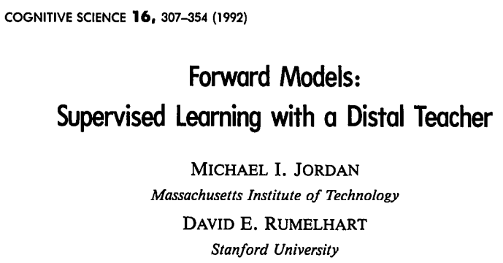
How to find an inverse?

Slide 21
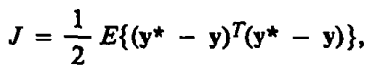
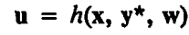
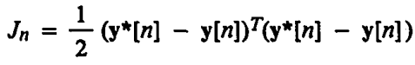
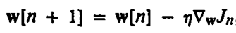
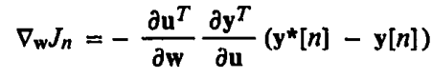
Use performance error!
Let’s do it sample (trial) by sample… online rule (Widrow & Stearns 1985)

Slide 22
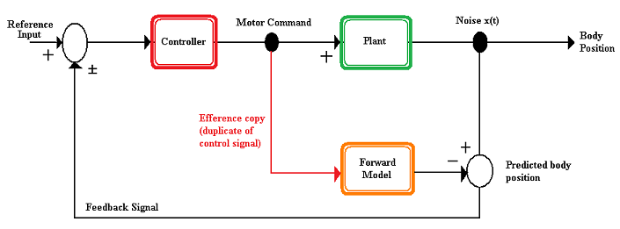
Why is dy/du not available to us? Because y is produced from u
Using an unknown plant (muscles) !
Therefore, this plant must be approximated by the brain… that is a FORWARD
MODEL!

Slide 23
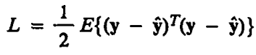
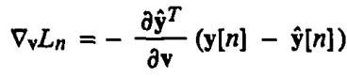
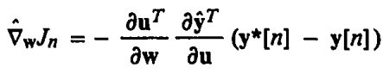
First, learn a forward model by prediction error
then learn an inverse model indirectly, approximating true input y with y^

Slide 24
Desired
Target
Performance error
y*[n]
Inverse Model
W
Predicted
Performance
error
y˄[n]
Prediction Error
y˄[n]
Forward Model
V
Action
u[n]
Unknown Plant
Q
y[n]
Actual
Feedback

Slide 25
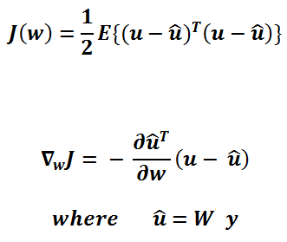
Direct Inverse Learning (Hanuschkin, Ganguli, Hahnloser 2013)
Can one learn an inverse without knowing a forward model?
- Can we do it without the need of a Teacher? (y*)
YES WE CAN!
IINVERSE
MODEL W
u^
noise
u
Unknown Plant Q
y

Slide 26
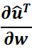
Algorithm for directly learning inverse
For n=1,2,.. N
Pick a value for u ~ N(μ,σ²)
Obtain y = Qu
Use u^ = W y
Find error u – u^ and jacobian
Use these quantities and update w
End for
Return W*
Then use W* to invert a desired y* ! ☺

Slide 27
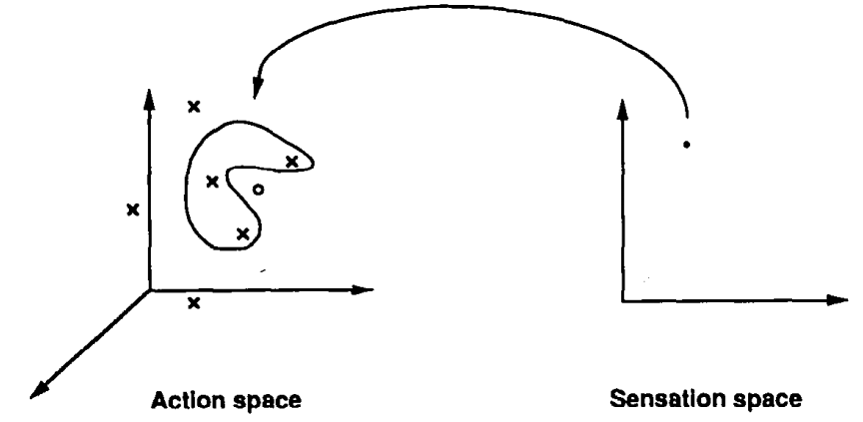
Non-convexity of inverse solutions

Slide 28
Advantages and disadvantages of the supervised learning approach
+ A general mathematical framework to define all motor control problems
+ The use of backpropagation with neural networks is easily used (and works better to approximate very non-linear plants)
+ The objective function (M.S.E) is convex and easily optimized (whether online learning really converges is another story)
Doesn’t provide easy solutions for the problem of “loop delay”
Sensory representations are assumed to be fixed and reliable (what about noise?)
Biologically plausible “backpropagation”?

Slide 29
Summary!
Ingredients of learning goal-directed motor learning:
Prediction error
Performance error
Reinforcement learning (to be contd.)
Why are songbirds an important animal model to study motor learning?
Supervised methods for learning :
a) Forward Models
b) Inverse Models

Slide 30
Fin
REFERENCES
Konishi M. 1963. The role of auditory feedback in the vocal behavior of the domestic fowl. Z.Tierpsychol.20:349–67
Doupe A.J., Kuhl P.K. 1999. Birdsong and human speech: Common themes and Mechanisms. Annu. Rev. Neurosci. 22:567-631
Catchpole C.K., Slater P.J.B. 1995. Birdsong: Biological themes and variations. Cambridge, UK: Cambridge Univ. Press.
Shadmehr R., Muss-Ivaldi F.A. 1994. Adaptive representation of dynamics during learning of a motor task. J Neuroscience 14, 3208-3224.
Sober S.J., Brainard M.S. 2012. Vocal learning is constrained by the statistics of sensorimotor experience. Proc. Nat. Acad. Sci. America. 109(51): 21099-21103.
Tumer E.C., Brainard M.S. 2007. Performance variability enables adaptive plasticity of “crystallized” adult birdsong. Nature 450(173): 1240-1244.
Jordan M.I., Rumelhart D.E. 1992. Forward Models: Supervised learning through a Distal teacher. Cognitive Science 16:307-354.
Hanuschkin A., Ganguli S., Hahnloser H.R. 2013. A Hebbian learning rule gives rise to mirror neurons and links them to control theoretic inverse models. Front. Neural Circuits 7: 106.

